Slide 1
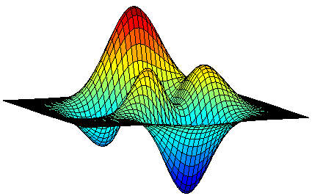

Guess Free Maximization of Submodular and Linear Sums
?
Moran Feldman
The Open University of Israel

Slide 2
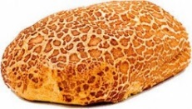

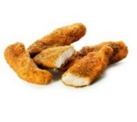


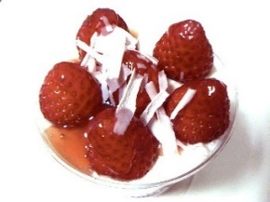
Motivation: Adding Dessert
Meal 1 | Meal 2
Alternative Definition
f(A) + f(B) ≥ f(A ∪ B) + f(A ∩ B)
∀ A, B ⊆ N.
Ground set N of elements (dishes).
Valuation function f : 2^{N}  ℝ (a value for each meal).
Submodularity: f(A + u) – f(A) ≥ f(B + u) – f(B)
∀ A ⊆ B ⊆ N, u ∉ B.

Slide 3


Another Example
7
11
0
6
8
0
5
10
5
N
4
-8

Slide 4
Submodular Optimization
Submodular functions can be found in:
Combinatorics
Machine Learning
Image Processing
Algorithmic Game Theory
Motivates the optimization of submodular functions subject to various constraints.
  Generalizes classical problems (such as Max DiCut and Max k-cover).
  Many practical applications.
In this talk, we only consider maximization of non-negative monotone submodular functions.
  f(A) ≤ f(B) ∀ A ⊆ B ⊆ N.

Slide 5
The Multilinear Relaxation
Sumodular maximization problems are discrete.
Nevertheless, many state of the art algorithms for them make use of a continuous relaxation (in the same way LPs are often used in combinatorial algorithms).
In the Linear World
Solve a linear program relaxation.
Round the solution.
Solve a multilinear relaxation.
In the Submodular World
Solve a relaxation.
Round the solution.
max w ∙ x
s.t. x ∈ P
max
s.t. x ∈ P
max F(x)
s.t. x ∈ P
It is a multilinear function…
The multilinear extension
Linear extension of the objective:
Agrees with the objective on integral vectors.
The Multilinear Extension
Given a vector x ∈ [0, 1]^{N},
F(x) is the expected value of f
on a random set R(x) containing each element u ∈ N with probability x_{u}, independently.

Slide 6
Continuous Greedy [Calinescu et al. 2011]
The first algorithm for (approximately) solving the multilinear relaxation
Description
Start at the point 0.
At every time between [0, 1], make a small step by adding an infinitesimal fraction of some vector x ∈ P.
The vector x chosen is the vector yielding the maximum improvement.
Can be (approx.) done because the step is infinitesimal.
+x
+εx

Slide 7
Analyzing Continuous Greedy
Feasibility
We end up with a convex combination of points in the polytope.
Lemma
The multilinear relaxation is concave along positive directions.
Use
Regardless of our current location, there is a good direction:
If y is the current solution,
then adding an infinitesimal fraction of OPT (in P) is at least as good as adding an infinitesimal fraction of OPT ∙ (1 – y),
which increases the value by at least an infinitesimal fraction of
F(y + OPT ∙ (1 – y)) – F(y) ≥ f(OPT) – F(y) .

Slide 8
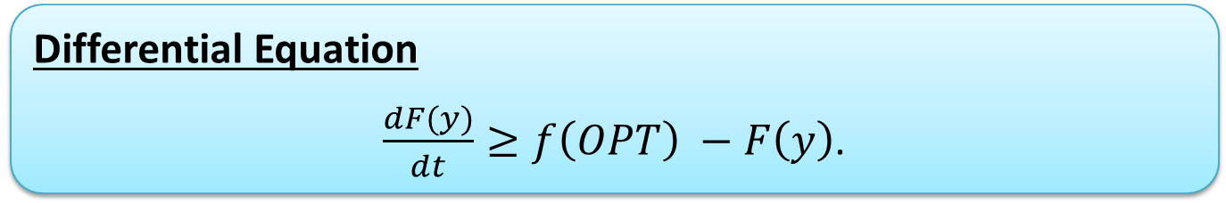
Approximation Ratio
Differential Equation
$\frac{dF(y)}{dt}≥f\left(OPT\right) −F\left(y\right)$.
Solution
F(y) ≥ (1 - e^{-t}) ∙ f(OPT).
For t = 1, the approximation ratio is 1 – 1/e ≈ 0.632.
Known to be tight.
Theorem
When f is a non-negative monotone submodular function, the multilinear relaxation can be optimized up to a factor of 1 – 1/e.

Slide 9

Are we done?
Theorem
When f is a non-negative monotone submodular function, the multilinear relaxation can be optimized up to a factor of 1 – 1/e.
Can we improve for special cases?
In ML one often needs to optimize f(S) – ℓ(S), where ℓ(S) is a linear regularizer.
Often non-monotone.
Hard to guarantee non-negativity.

Slide 10
Linear and Submodular Sums
Σ
Theorem [Sviridenko, Vondrák and Ward (2017)]
When f is the sum of a non-negative monotone submodular function g and a linear function ℓ, one can find in a polynomial time a vector x ∈ P such that
F(x) ≥ (1 – 1/e) ∙ g(OPT) + ℓ(OPT) .
Every non-negative monotone submodular f can be decomposed in this way.
Improved approximation ratio when the linear component ℓ of OPT large.
Have a guarantee also when the linear regularizer makes the function non-monotone or makes it negative at some points.

Slide 11

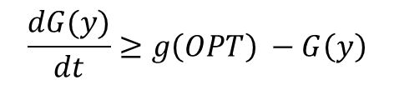
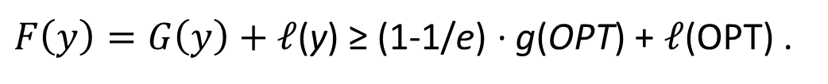
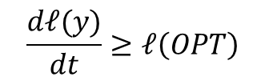
About the Alg. of Sviridenko et al.
We already saw adding an infinitesimal fraction of OPT increases g by an infinitesimal fraction of
g(OPT) – G(y) .
Doing so also increases ℓ by an infinitesimal fraction of
ℓ(OPT) .
By guessing ℓ(OPT) we can use an LP to find a direction with these guarantees.
$F\left(y\right)=G\left(y\right)+\text{ℓ}$(y) ≥ (1-1/e) ∙ g(OPT) + $\text{ℓ}$(OPT) .
Equation:
At t = 1, G(y) ≥ (1 – 1/e) ∙ g(OPT).
Equation:
At t = 1, ℓ(y) ≥ ℓ(OPT).
$$\frac{dG(y)}{dt}≥g\left(OPT\right) −G\left(y\right)$$
$$\frac{d\text{ℓ}(y)}{dt}≥\text{ℓ}\left(OPT\right)$$

Slide 12

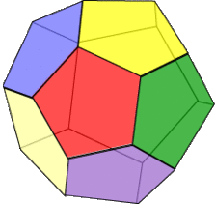
Shortcomings of the Above Algorithm
Expensive and Involved Guessing
The algorithm has to be run for many guesses for ℓ(OPT).
Slows the algorithm, and complicates its implementation.
LP Solving
In general, even the basic version of continuous greedy requires solving an LP. However, this can sometimes be avoided when the constraint polytope P has extra properties.
The additional constraint in the algorithm of Sviridenko et al. prevents this saving.
Matroid Speedup
Tricks developed for speeding up continuous greedy for matroid constraints cannot be applied for the same reason.

Slide 13

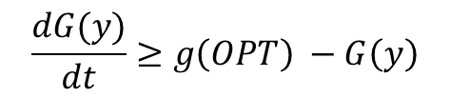
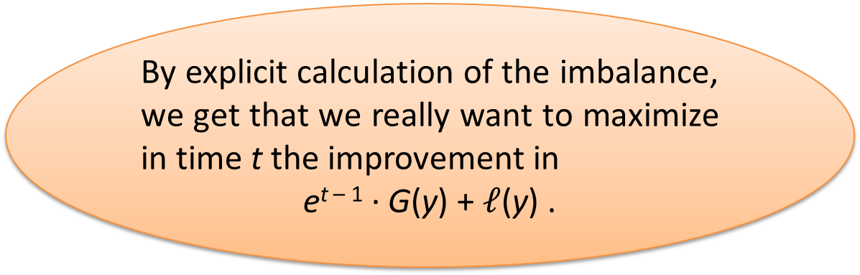

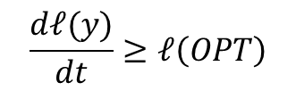
Our Observation
$$\frac{dG(y)}{dt}≥g\left(OPT\right) −G\left(y\right)$$
$$\frac{d\text{ℓ}(y)}{dt}≥\text{ℓ}\left(OPT\right)$$
By explicit calculation of the imbalance, we get that we really want to maximize in time t the improvement in
e^{t – 1} ∙ G(y) + $\text{ℓ}$(y) .
Every extra gain now decreases the guarantee at later times.
The gain now does not affect later guarantees.
Gaining in $\text{ℓ}$ is more important than gaining in G.
This imbalance reduces with time.

Slide 14

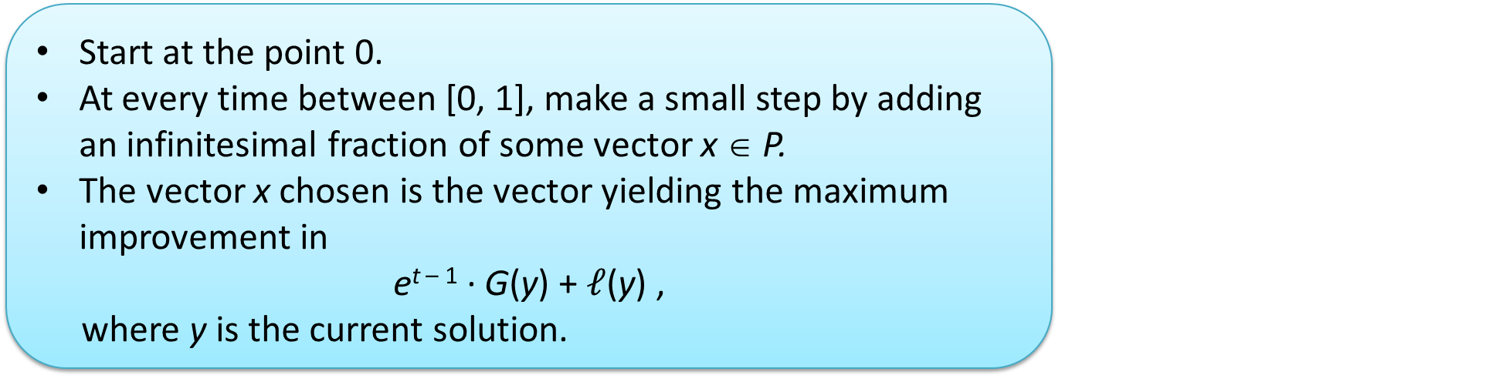
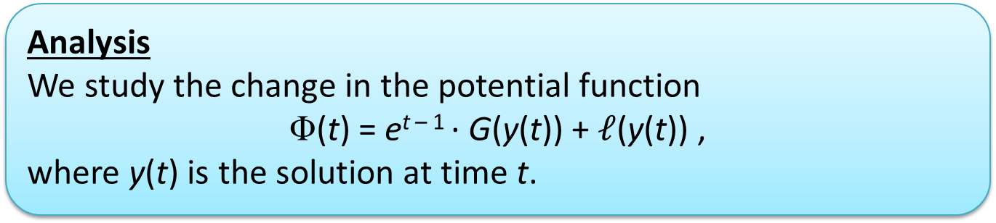
Our Algorithm
Start at the point 0.
At every time between [0, 1], make a small step by adding an infinitesimal fraction of some vector x ∈ P.
The vector x chosen is the vector yielding the maximum improvement in
e^{t – 1} ∙ G(y) + $\text{ℓ}$(y) ,
where y is the current solution.
No guesses
No extra constraints
Analysis
We study the change in the potential function
Φ(t) = e^{t – 1} ∙ G(y(t)) + $\text{ℓ}$(y(t)) ,
where y(t) is the solution at time t.

Slide 15
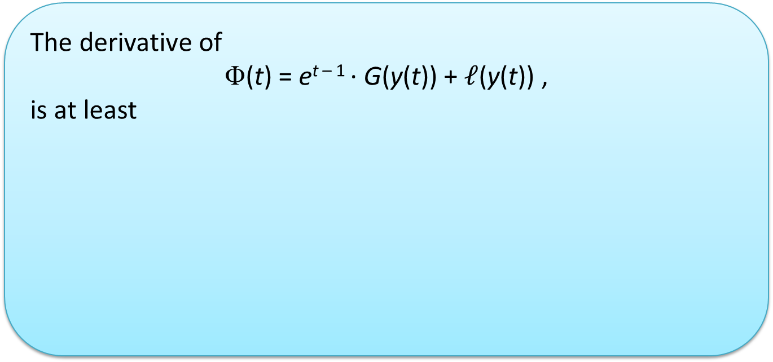
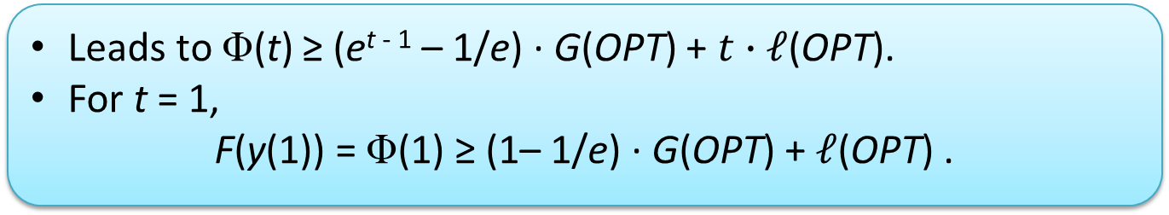
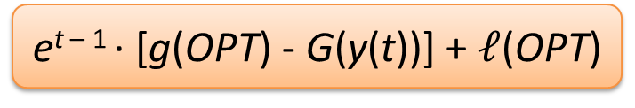
Analysis (cont.)
The derivative of
Φ(t) = e^{t – 1} ∙ G(y(t)) + $\text{ℓ}$(y(t)) ,
is at least
e^{t – 1} ∙ G(y(t))
e^{t – 1} ∙ [g(OPT) - G(y(t))] + $\text{ℓ}$(OPT)
Due to increase in e^{t – 1}
The x chosen is at least as good as OPT
Leads to Φ(t) ≥ (e^{t - 1} – 1/e) ∙ G(OPT) + $t∙\text{ℓ}$(OPT).
For t = 1,
F(y(1)) = Φ(1) ≥ (1– 1/e) ∙ G(OPT) + $\text{ℓ}$(OPT) .

Slide 16



Follow Up Work
A follow up work recently appeared in ICML 2019. [“Submodular Maximization beyond Non-negativity: Guarantees, Fast Algorithms, and Applications” by Harshaw, Feldman, Ward and Karbasi]
Results
In this work we got the same approximation guarantee, but using faster algorithms, for cardinality constraint and the unconstrained problem.
Extended the guarantee to weakly submodular functions.
Technique
Applied the same basic observation, but not to continuous greedy, but to a random greedy algorithm due to [Buchbinder et al. (2014)].

Slide 17
Questions
?

